Slide 1
Trajectory Optimisation for Target-in-range problems
FYP Presentation
Supervisor: Dr. Yuanbo Nie
Nikilesh Ramesh
16/05/2024
Notes:
Switch the titles

Slide 2
Main Aim and Contributions
Aim
To formulate a framework for a Target-In-Range tracking problems
Contributions
1. A framework for the in-range tracking problems was formulated and successfully demonstrated with examples.
2. The framework was disseminated via a conference paper submitted to IFAC conference on Nonlinear Model Predictive Control which has since been accepted and will be featured in the proceeding after the conference in august.

Slide 3
Overview
Motivation
Background
Formulation
Demonstration
Conclusion
Notes:
Add one of the results instead of buildig

Slide 4
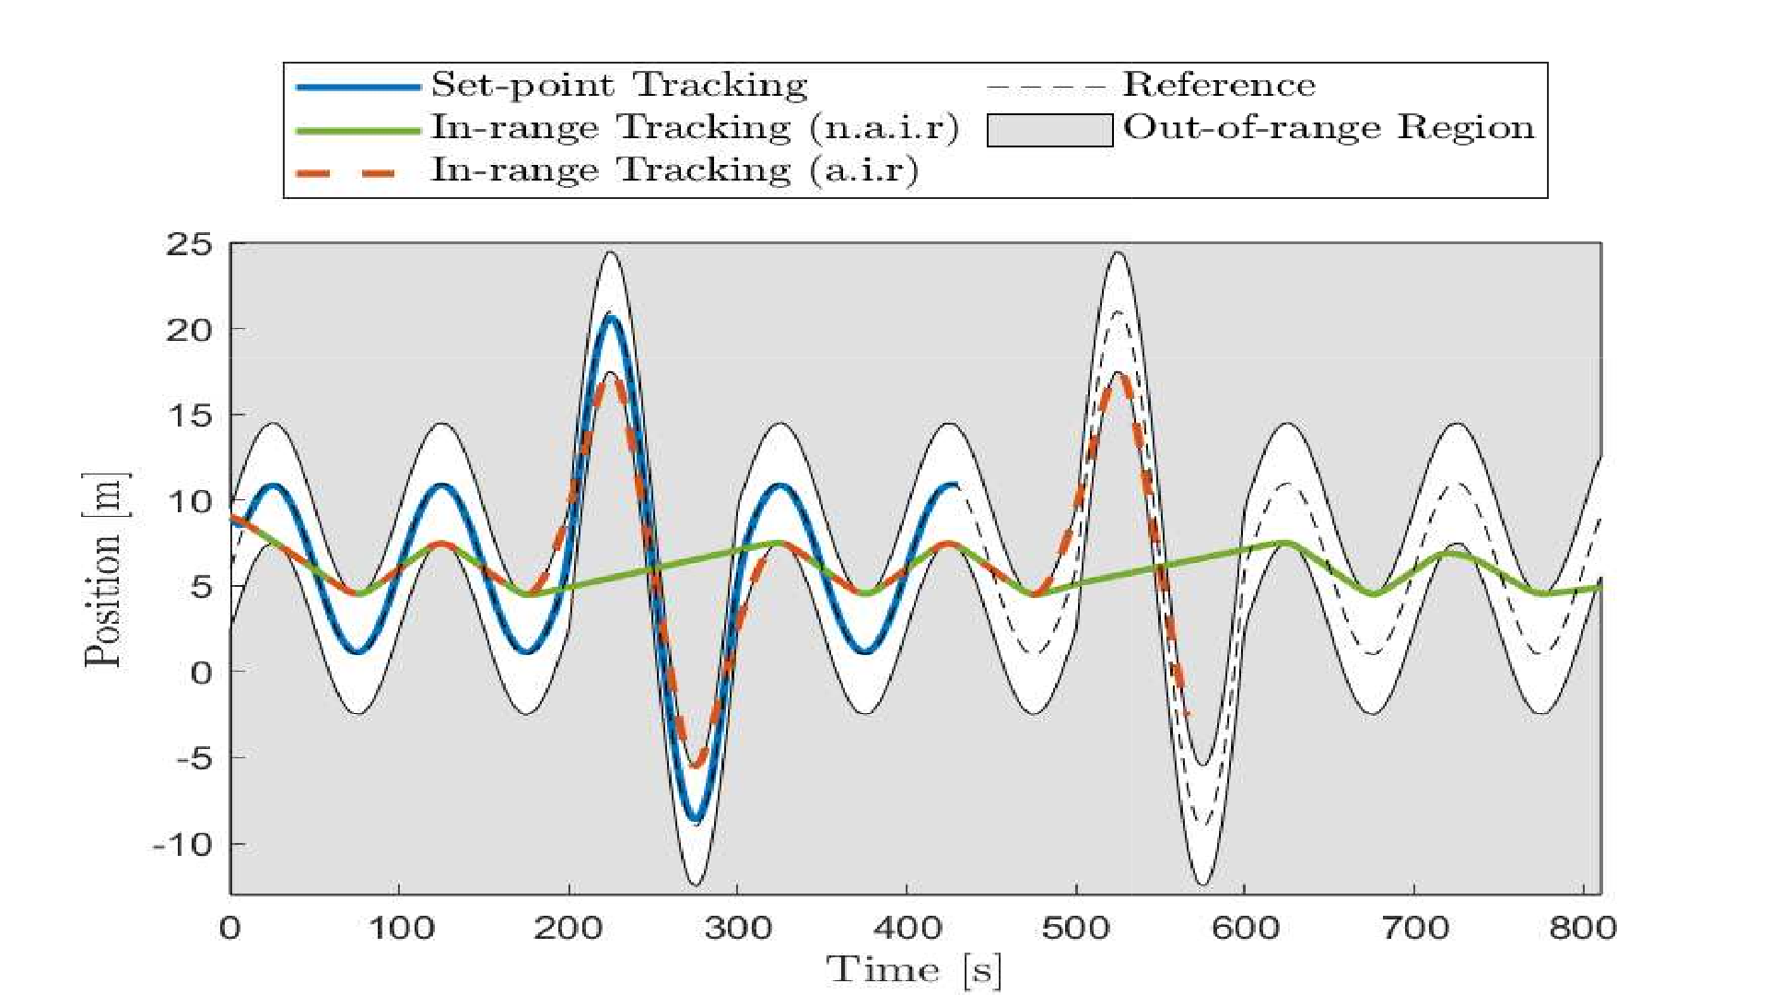
Motivation

Slide 5
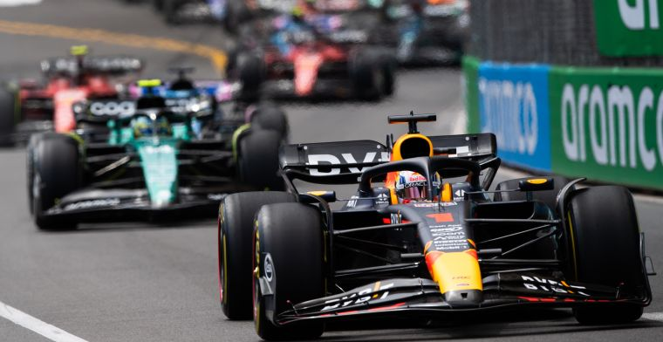
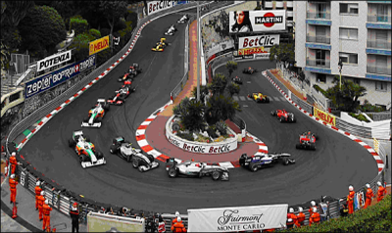
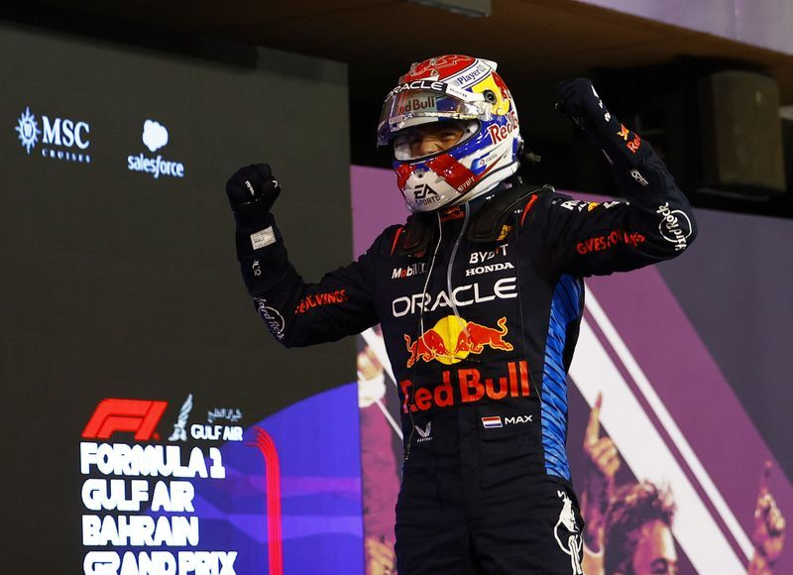
Motivation: Formula One (I)
Consider the case where a F1 race is being tracked with a single autonomous drone.
Optimise for maximum entertainment value and minimise energy use.
How do you choose the setpoint for tracking?
Do you choose the car in the mean position?
So do you choose the car in the first position?
Figure: Monaco corner from formula1-dictionary.net
Figure: Max Verstappen from GPblog
Notes:
Add image of a bend and show shortcuts

Slide 6
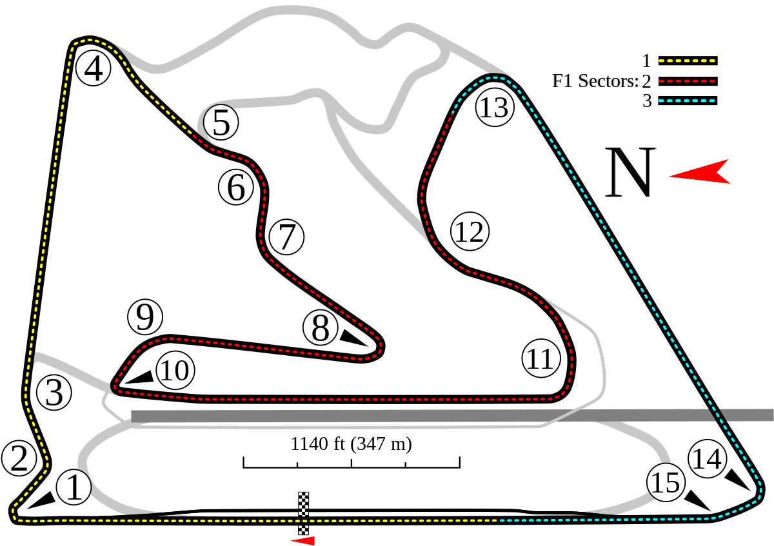
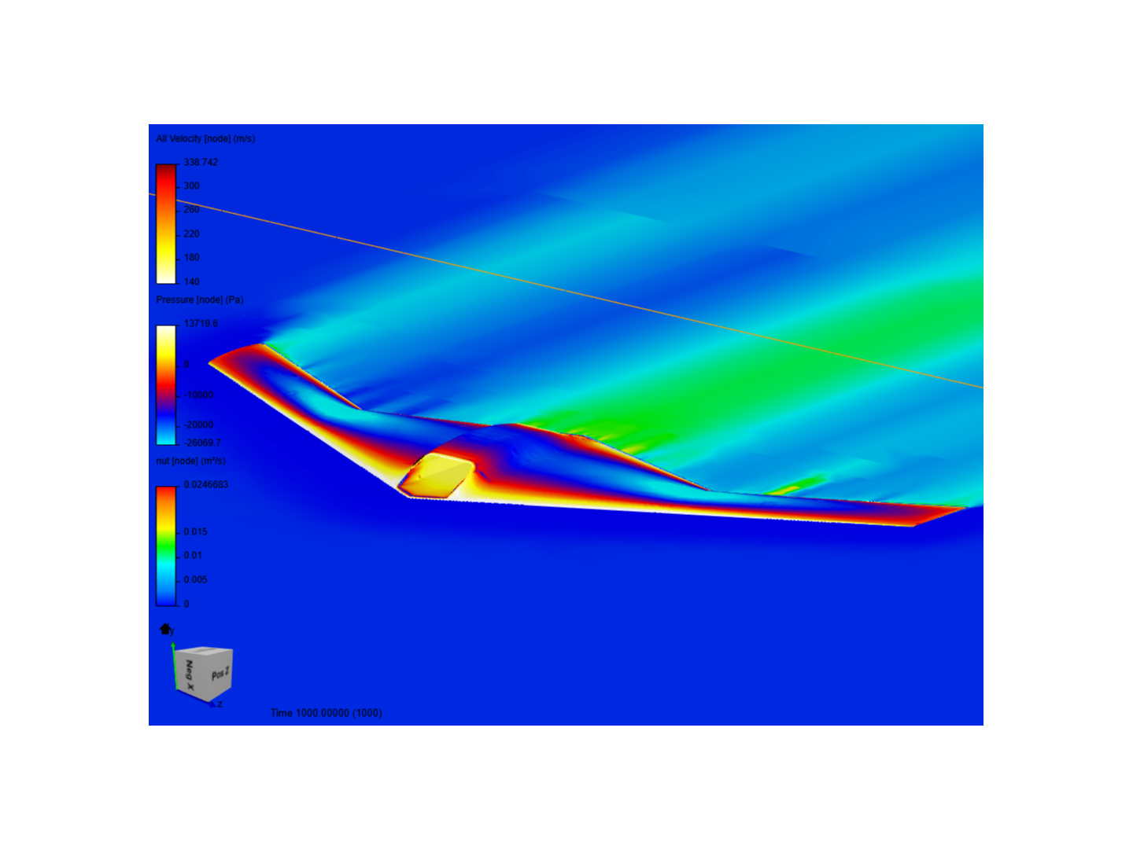
Motivation: Formula One (III)
Map of Bahrain GP.
Efficiency and Entertainment value vs tracking behavior.
Why Trajectory Optimisation?
The most efficient path between two points may not be a straight line cause of physics of the tracker.

Slide 7
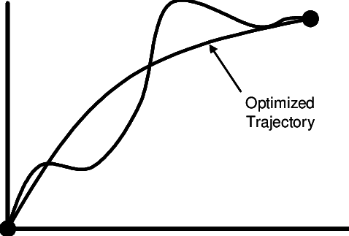
Background
Figure from Thompson, Robert & Krevor, Zachary & Young, David & Wilhite, Alan. (2007). A Reduced Order Lunar Lander Model for Rapid Architecture Analysis. 10.2514/6.2007-6623.

Slide 8
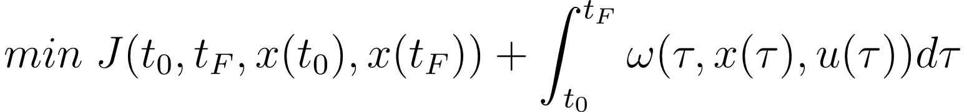
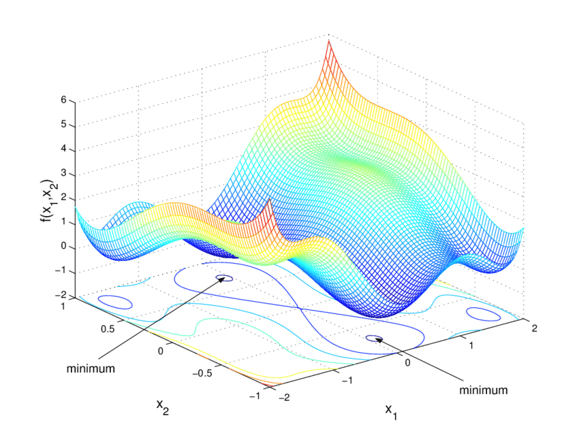
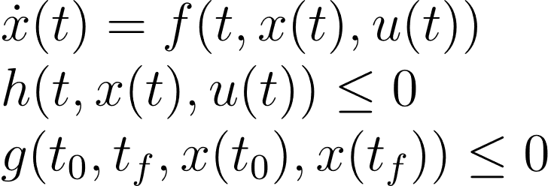
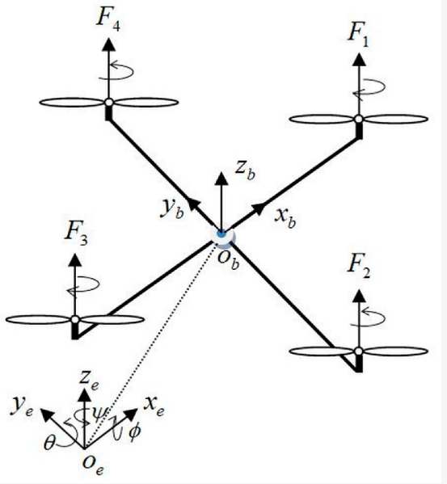
Background (I): Optimal Control Problem
OCPs are posed to find the optimal control input trajectory to minimise an objective function subject to dynamics and mission constraints
Cost
Constraints

Slide 9
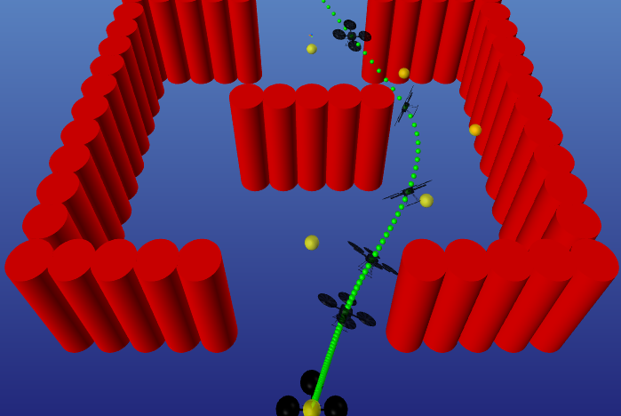
Formulation
Figure from T. A. Howell, B. E. Jackson, and Z. Manchester, ‘ALTRO: A Fast Solver for Constrained Trajectory Optimization’, in IEEE/RSJ International Conference on Intelligent Robots and Systems (IROS), 2019.

Slide 10
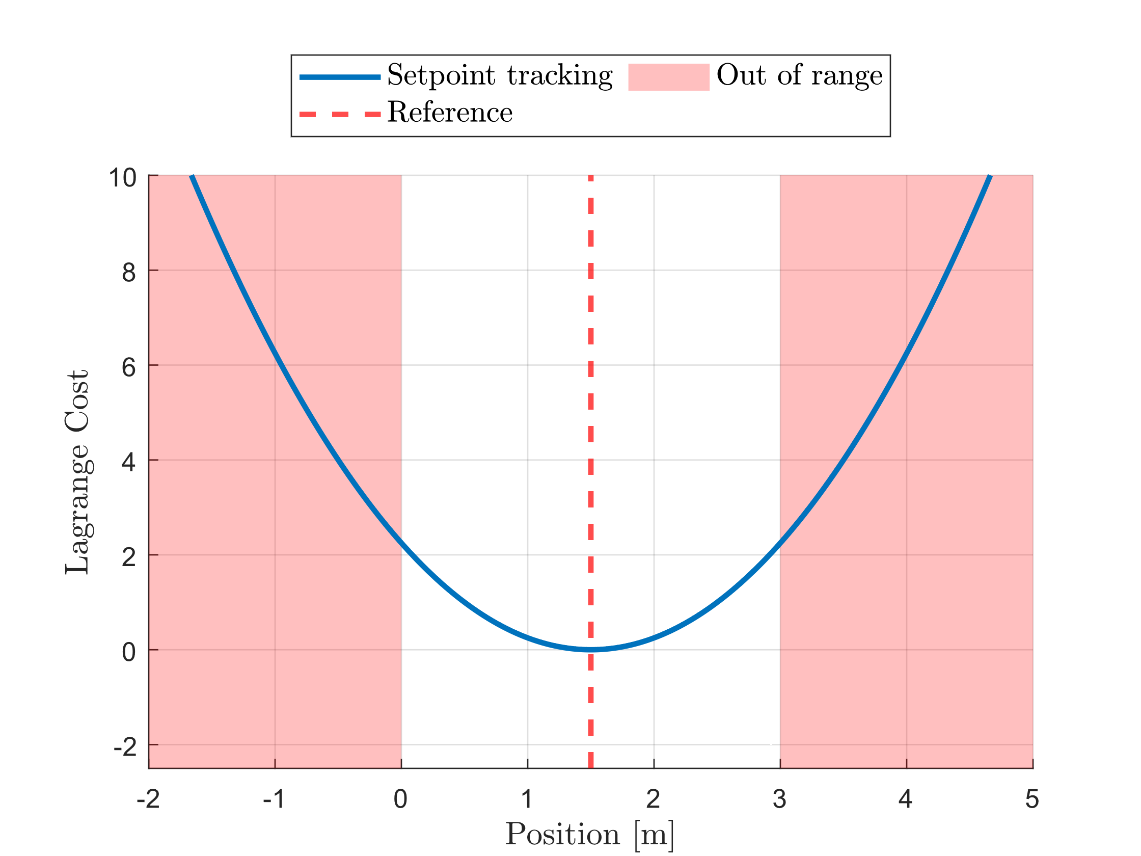
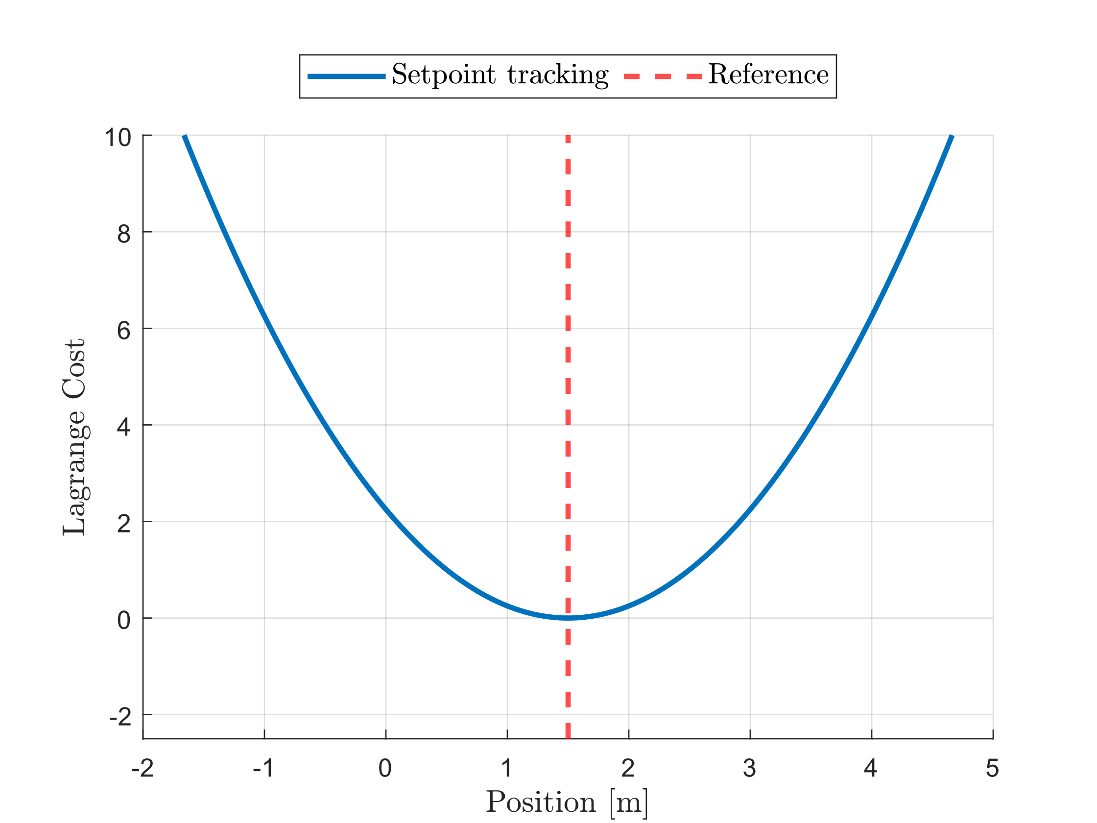
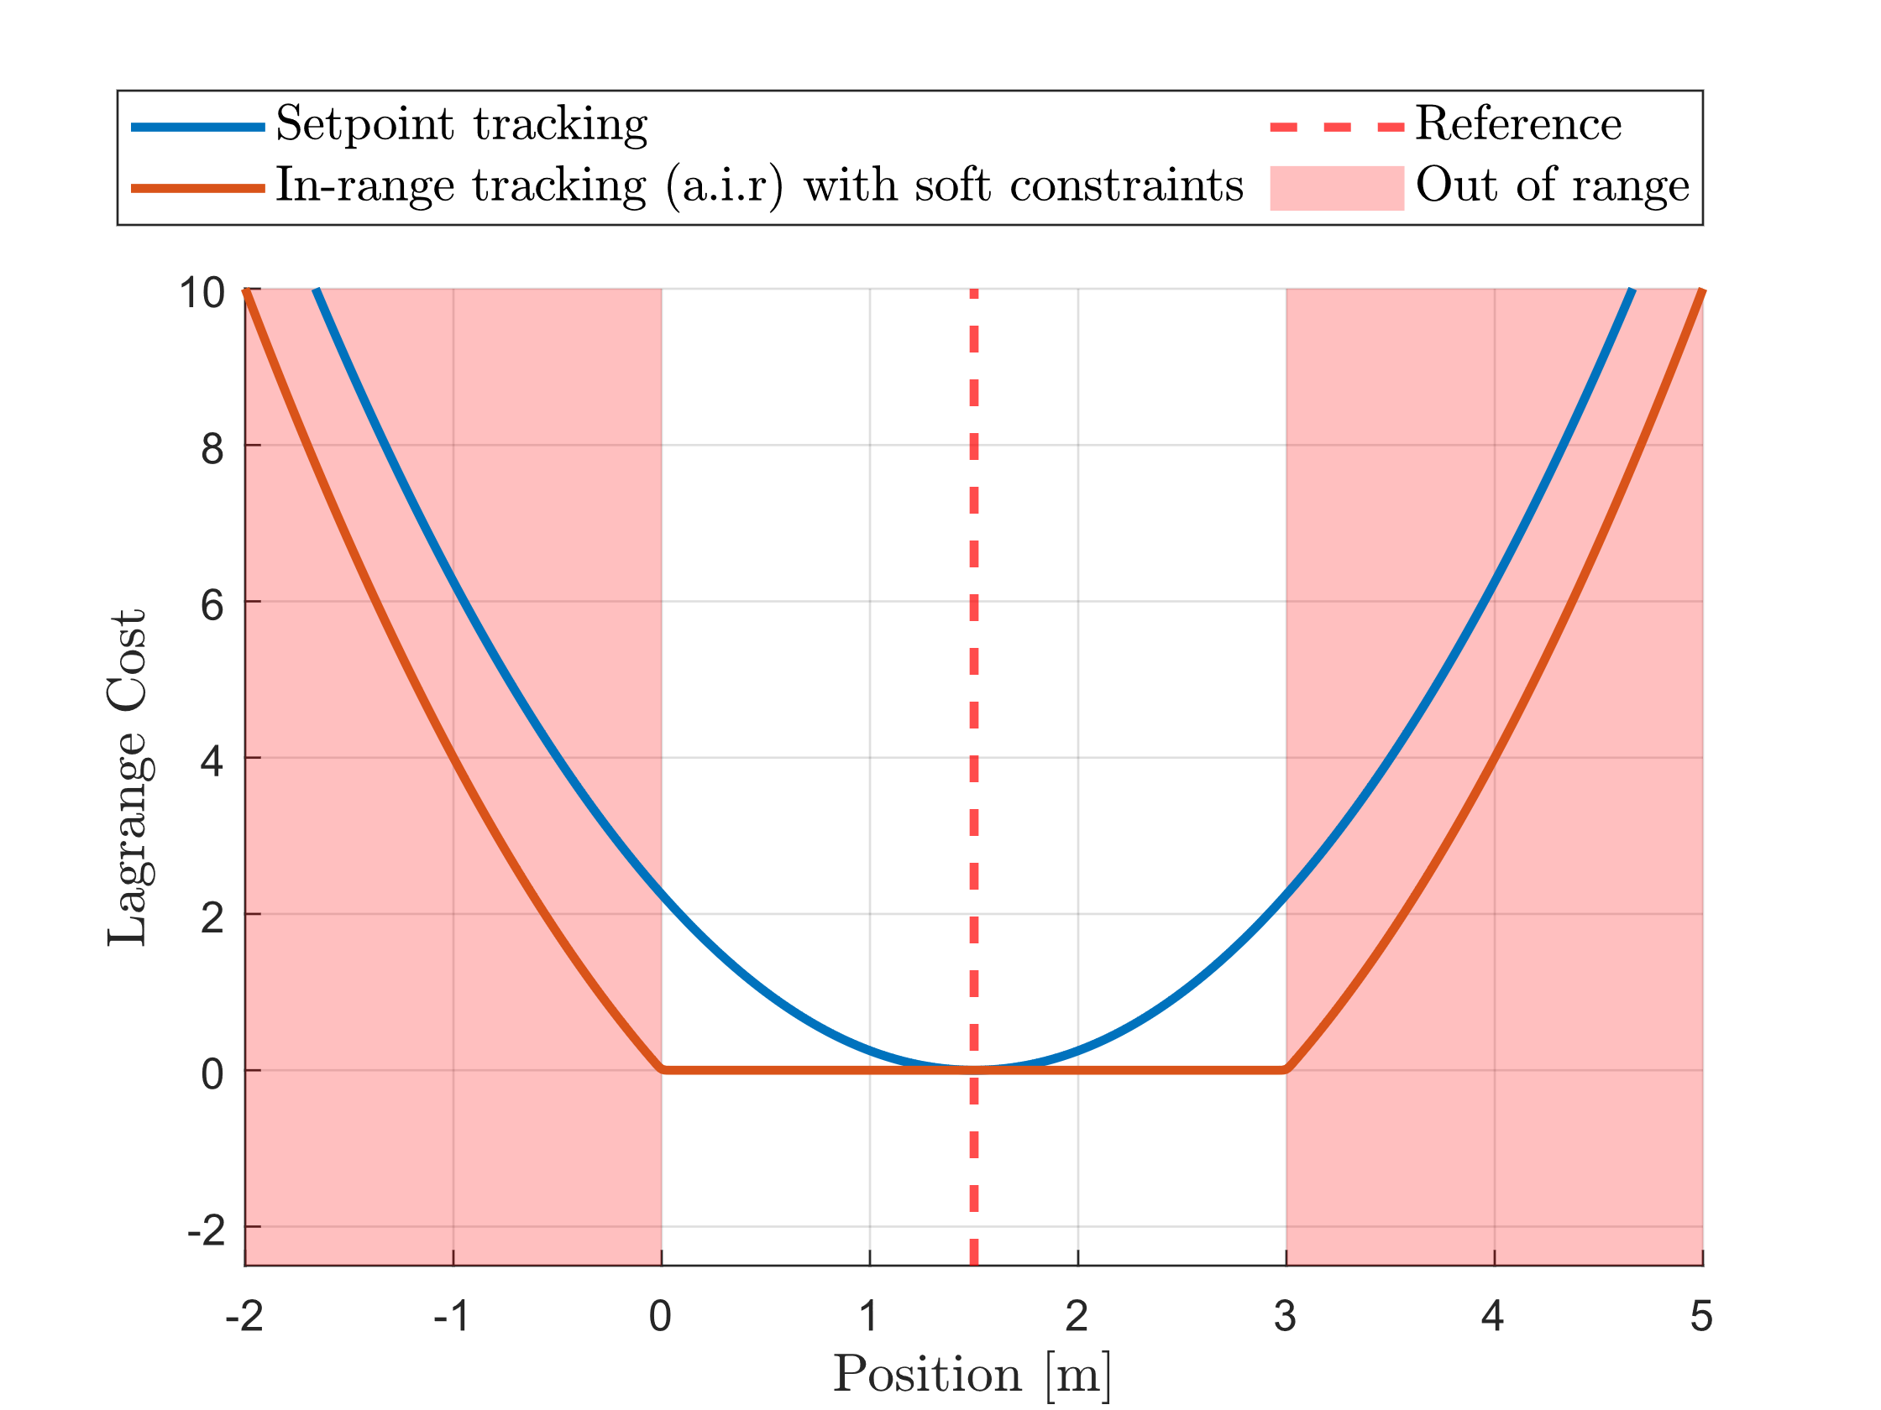
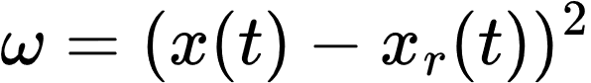
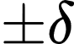
Formulation (I): In-range Behavior
Setpoint Tracking Lagrange Cost
Introduce the range
Always In-range Tracking Lagrange Cost

Slide 11
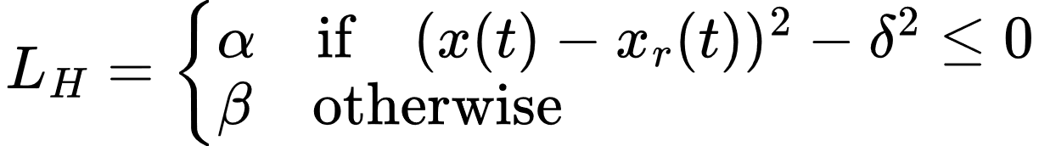
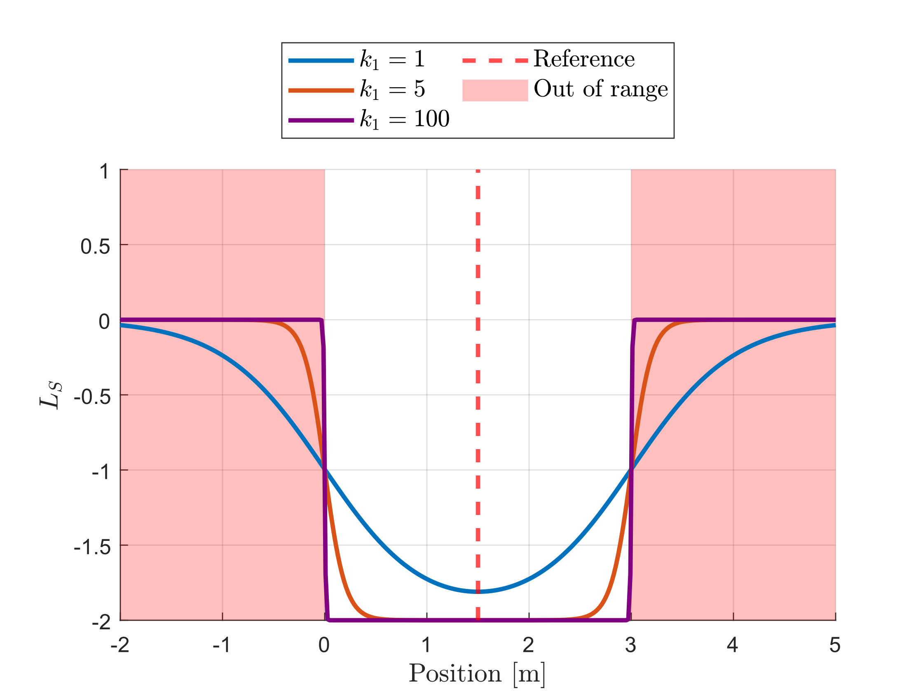
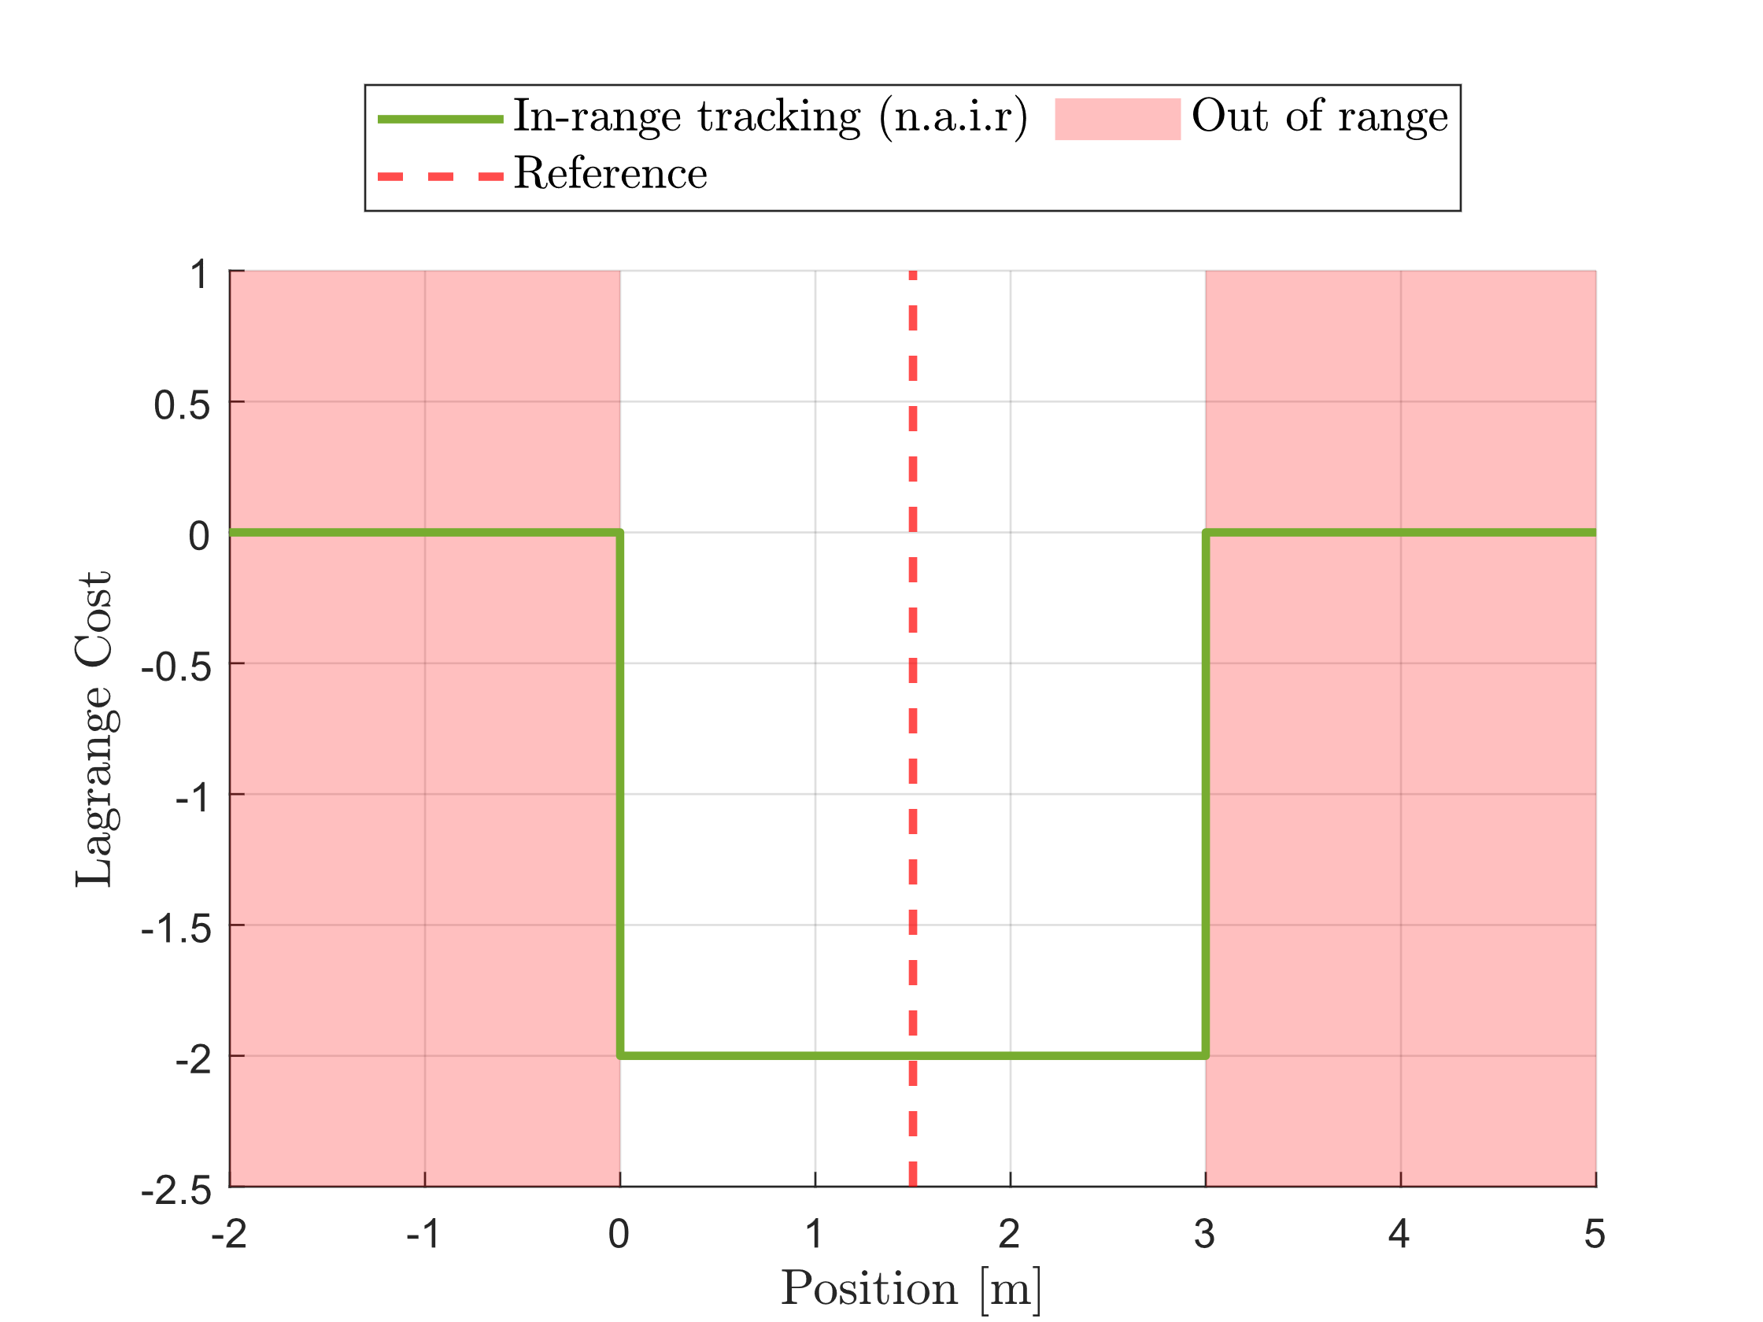
Formulation (II): Out-of-range Behavior
Ideal cost function
Approximate cost function

Slide 12
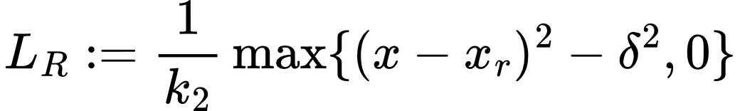
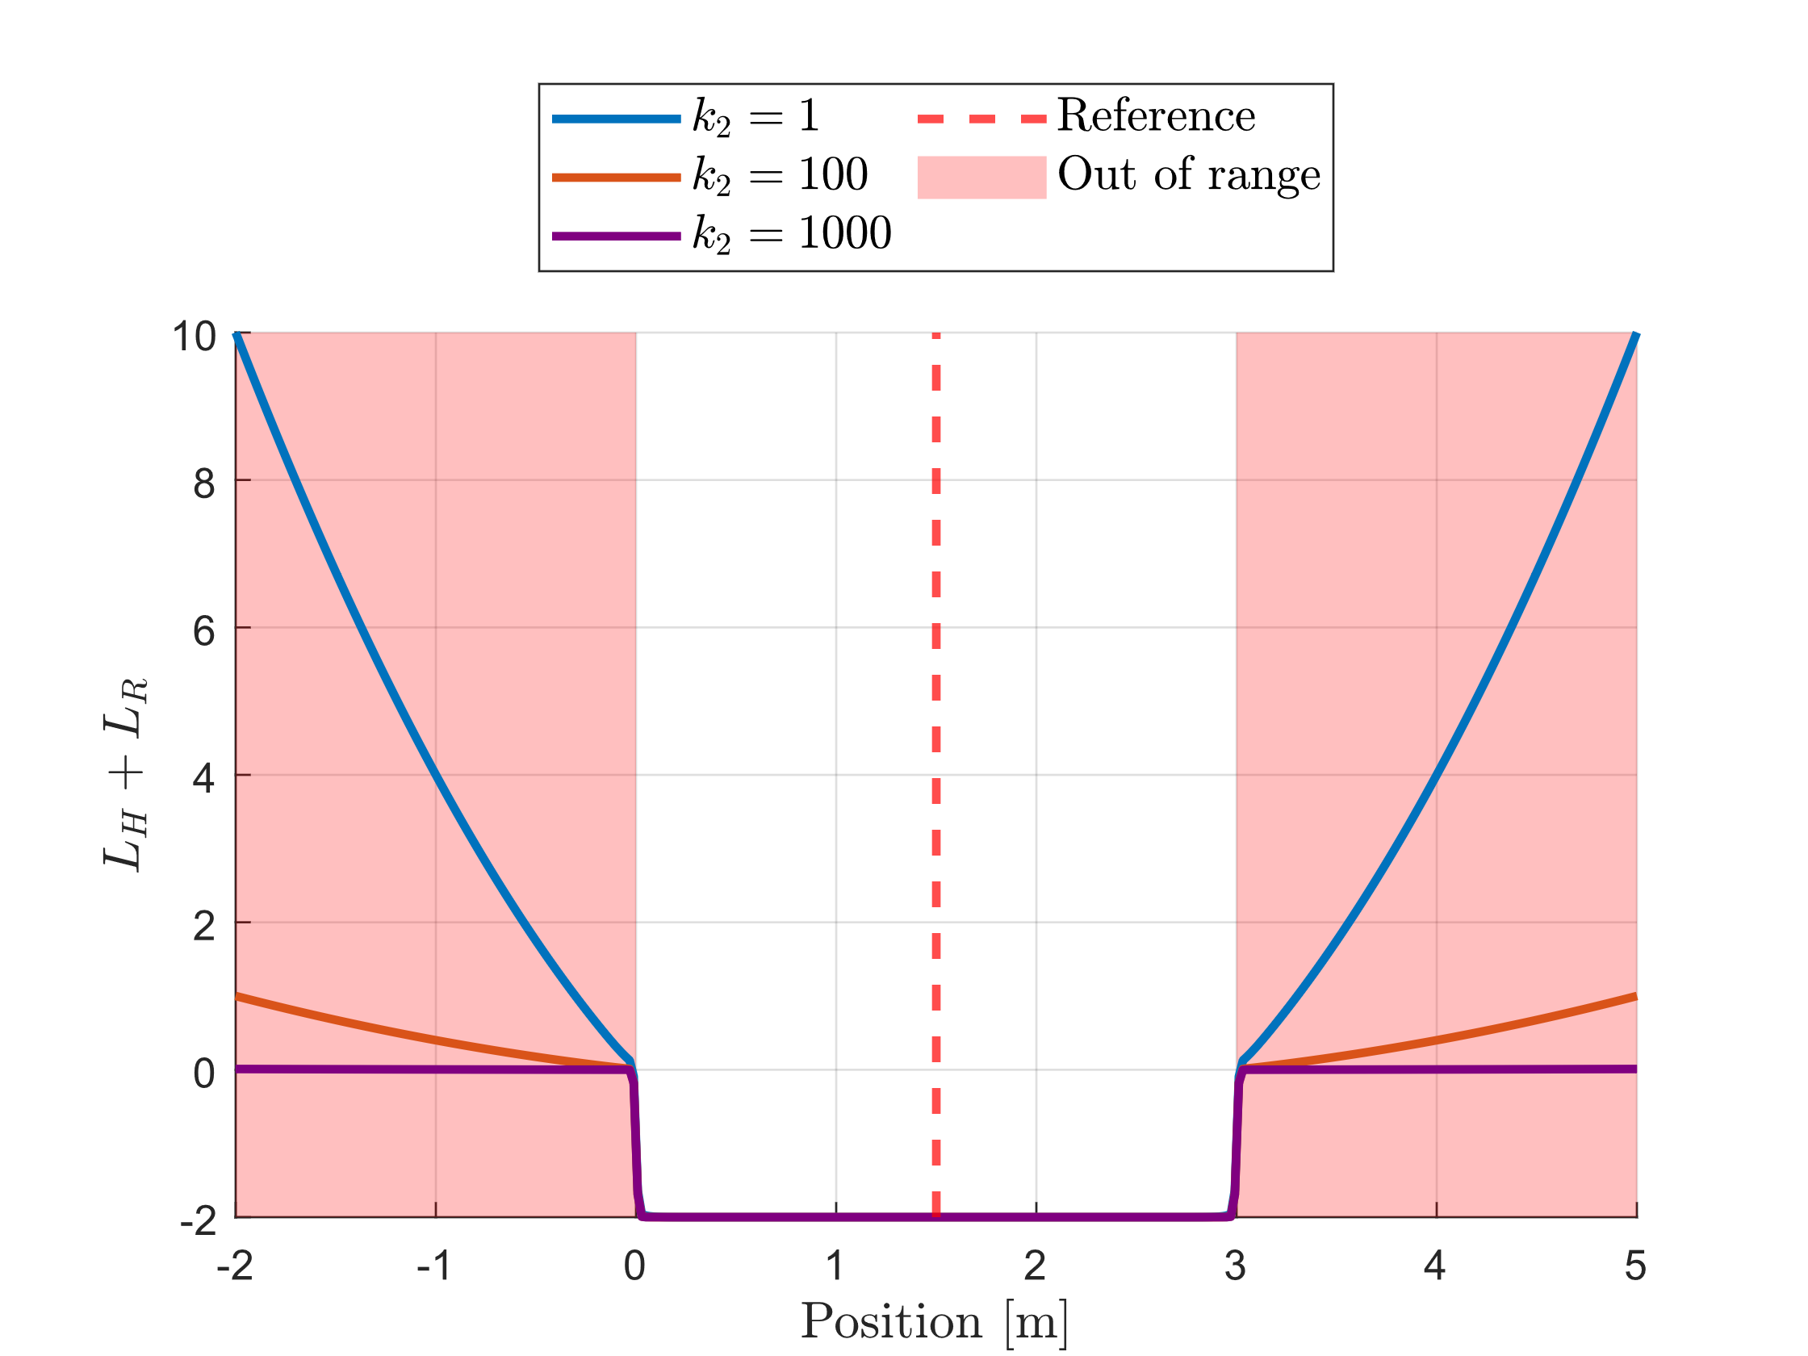
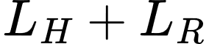
Formulation (III): Regularisation
Introducing regularisation to deal with the lack of gradient information when the tracker out of range.
Small enough to have minimal effects on the overall framework.
After regularisation
Figure: Cost with varying K1 parameter
Figure: Regularised Cost with varying K2 parameter and a fixed K1

Slide 13
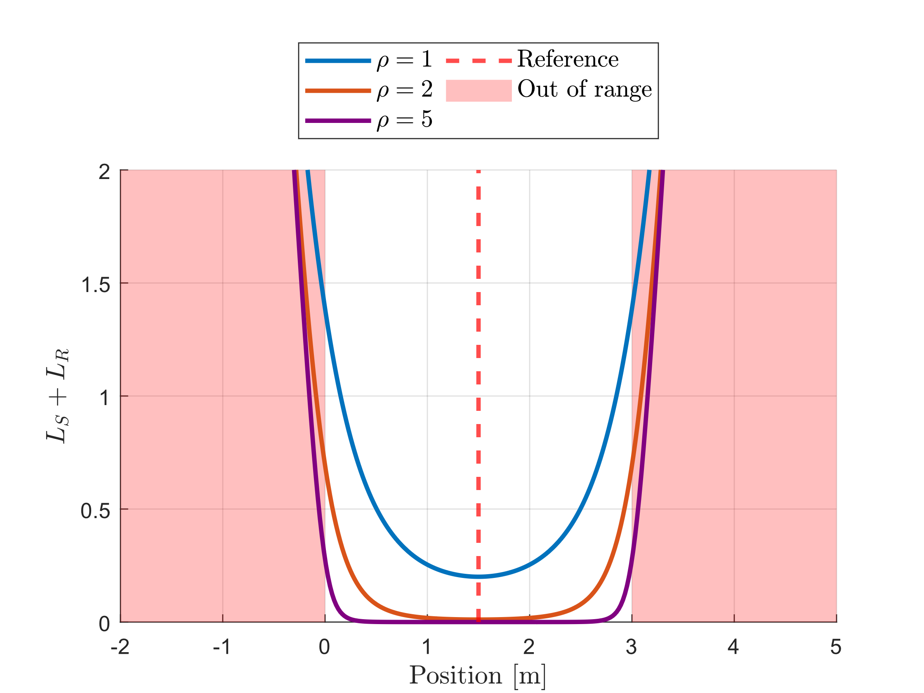
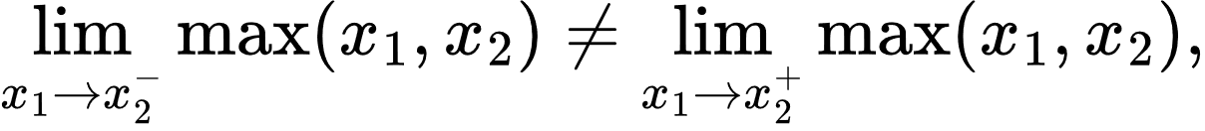
Formulation (IV): Smooth Maximum
Maximum operator is discontinuous
Log-Sum-Exp Function to approximate the maximum operator
Such that
Figure: AIR soft constraint with varying rho
Notes:
Go through all equations

Slide 14
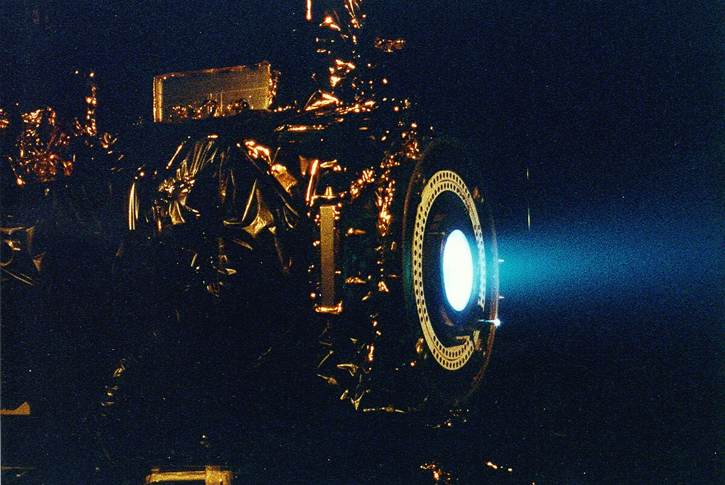
Formulation Demonstration

Slide 15
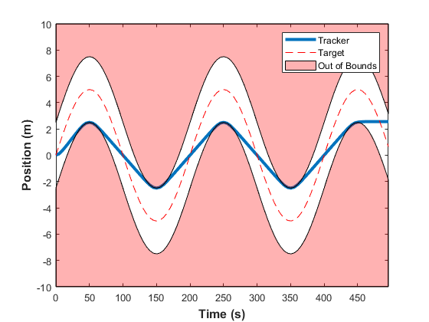
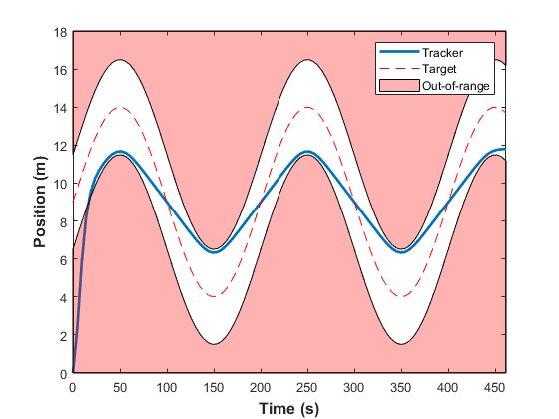
Demonstration (I): Always-in-range
Always-in-range tracking with double integrator dynamics
A.I.R. Tracking with path constraints
A.I.R. Tracking with Soft constraints
Initial Condition
Notes:
Add initial conditions

Slide 16
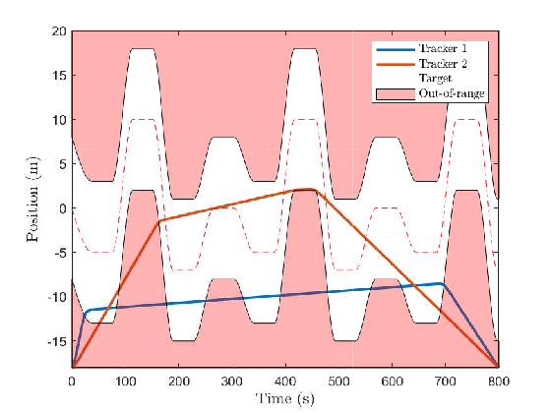
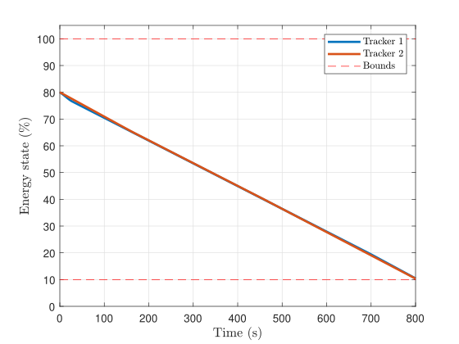
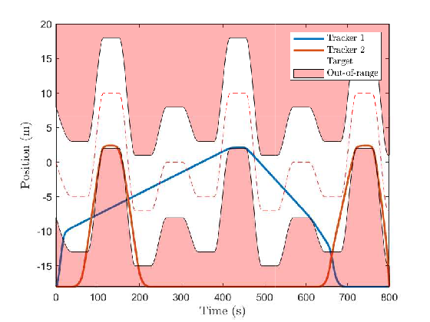
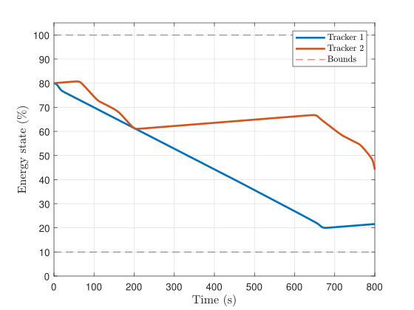
Demonstration (II): Multiagent
Double trackers
Fixed terminal time
Optimised for energy
Simple energy model
Double trackers
Fixed terminal time
Optimised for energy
Energy model with wireless charging

Slide 17
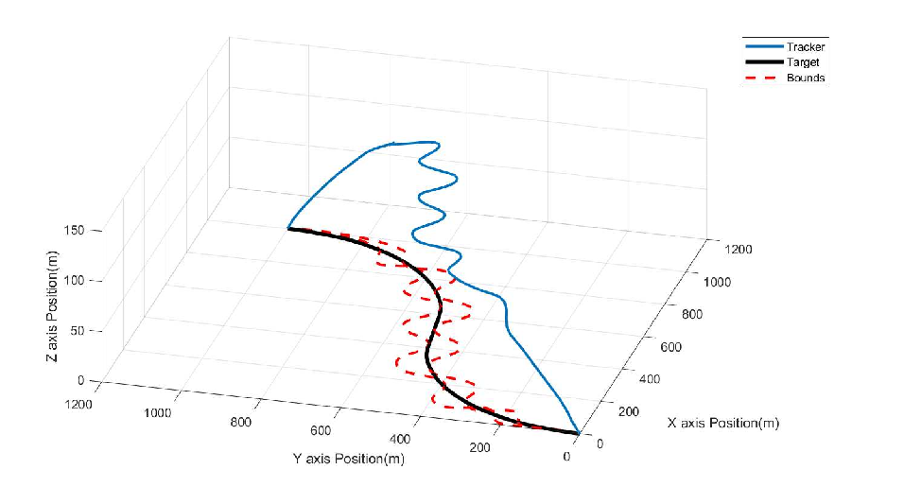
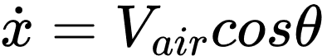
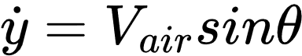

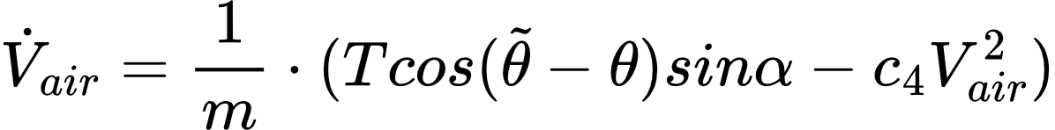
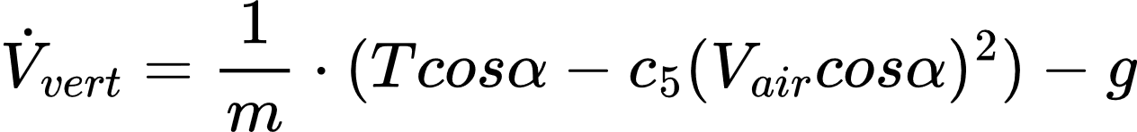
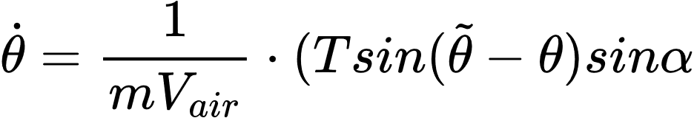
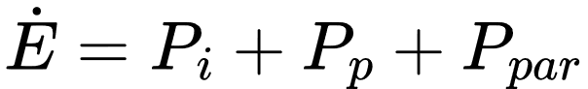
Demonstration (III): Higher Dimensions
Always-in-range tracking with fixed wing UAV in 3D
Range based on the height of drone
Dynamics given below
Notes:
Add power to speed and drag to speed graphs

Slide 18

Conclusion
Figure: Low Earth Orbit form IGN

Slide 19
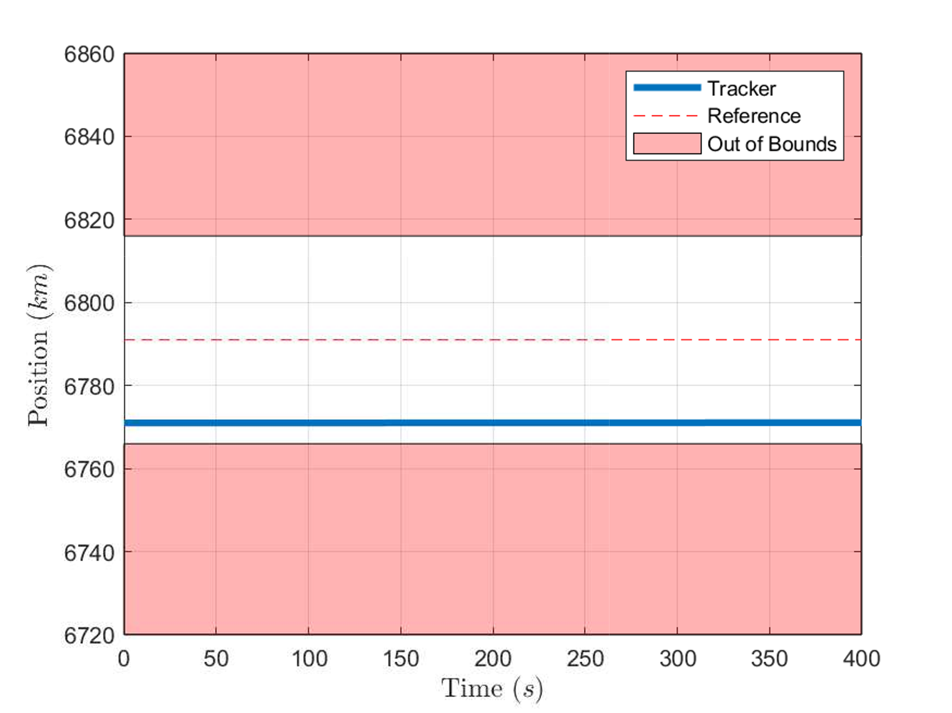
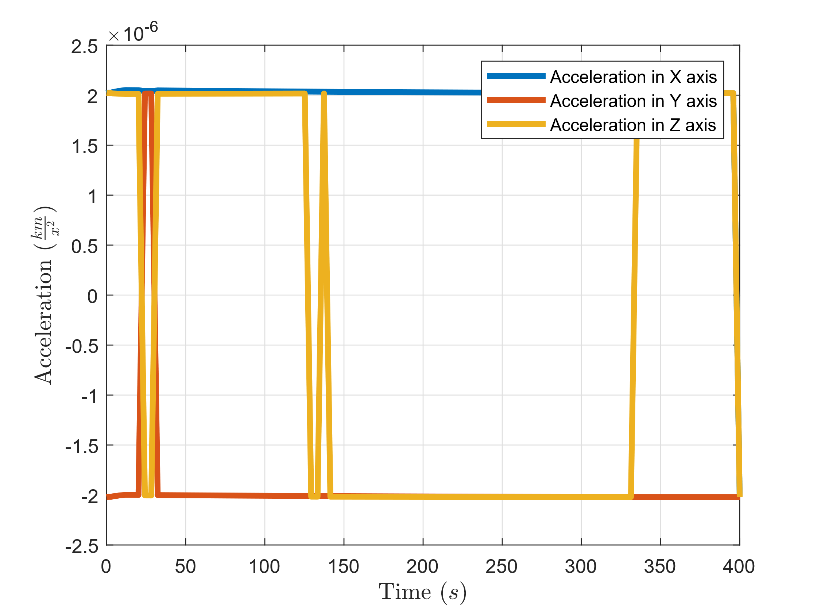
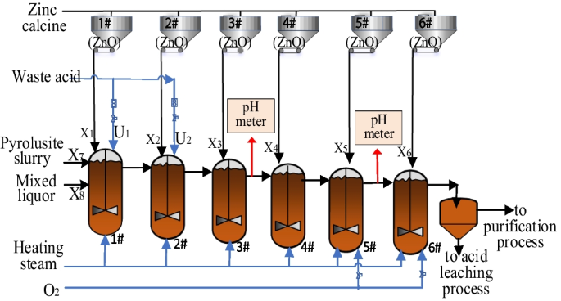
Future Work: Applications
Low Earth Orbit Satellite Keeping with constant acceleration profile from electric propulsion
Always in range tracking solution for satellite keeping
Continuous-Stirred Tank Reactors control in Zinc metallurgy
Figure from :H. Zhu, Y. Shang, J. Du, C. Zhou, and X. Liu, “A fuzzy control method based on rule extraction
for zinc leaching process of zinc hydrometallurgy,” Mining, Metallurgy & Exploration, vol. 40

Slide 20
Conclusion
The project objective to present a framework for in-range tracking was successfully completed
In-range tracking can be a better paradigm for tracking compared to set point for suitable problems especially when there are multiple objectives along with the primary tracking objective.
Common problems that could benefit from this paradigms are the problems most concerned with efficiency of tracking and this is handled better by in-range tracking as demonstrated.
Notes:
More compact

Slide 21
Any questions?
Joe.bloggs@Sheffield.ac.uk

Slide 22
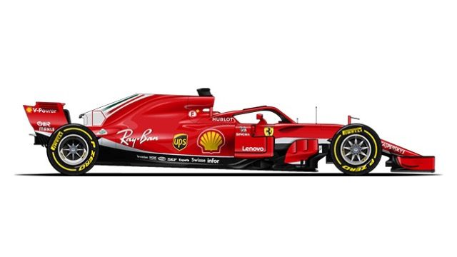
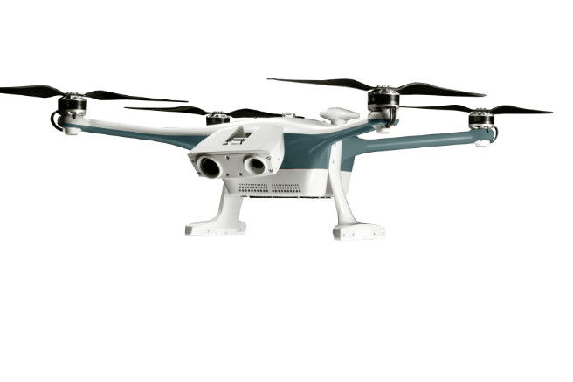
Motivation: Case Study (II)

